Slide 1


Quality Management
VIDEO PRESENTATION
4/14/2026

Slide 2


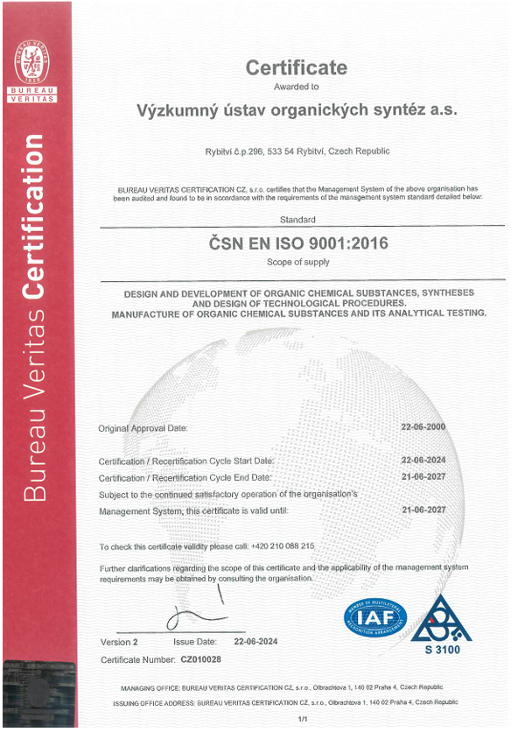
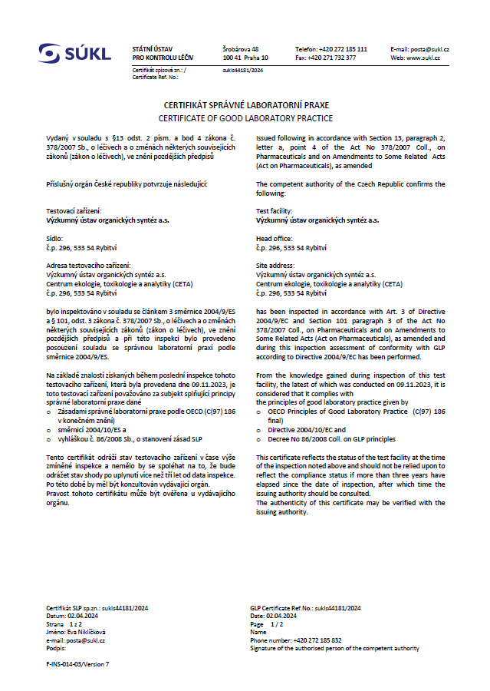
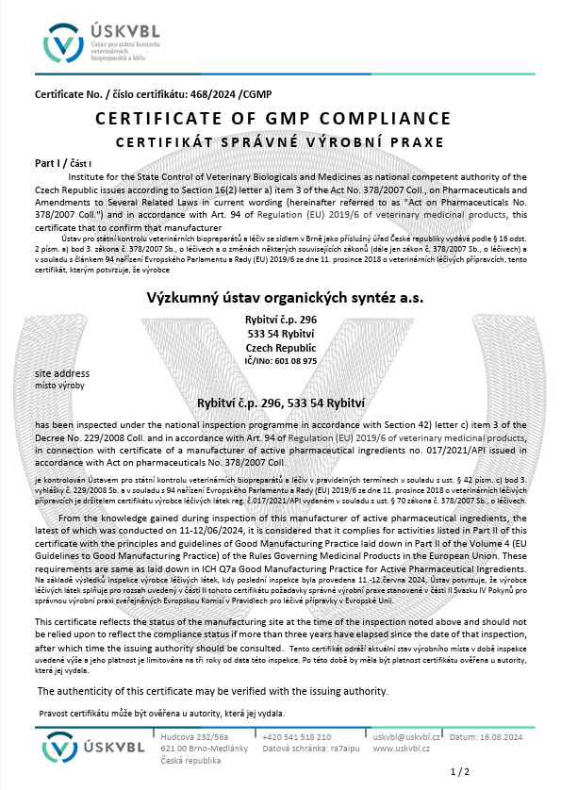

Robust Quality Systems
Certification: ISO 9001:2016, GMP, GLP
Audited by Czech and EU Authorities
Audited by many customers
2

Slide 3
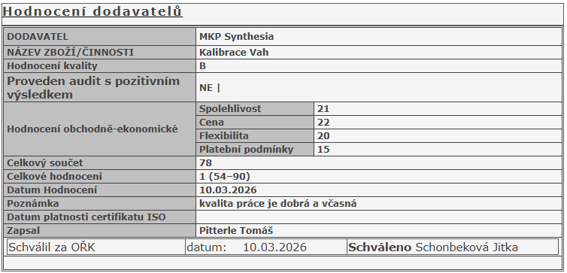
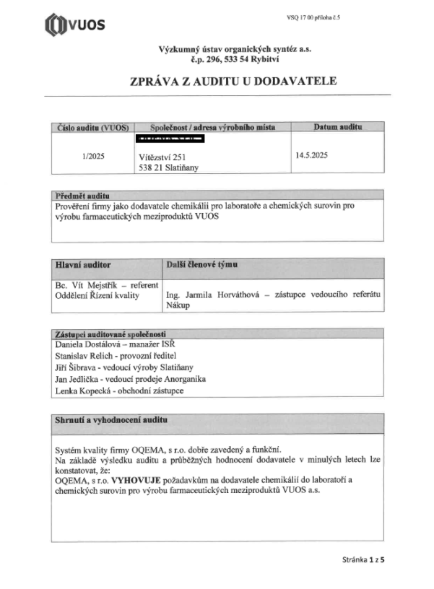
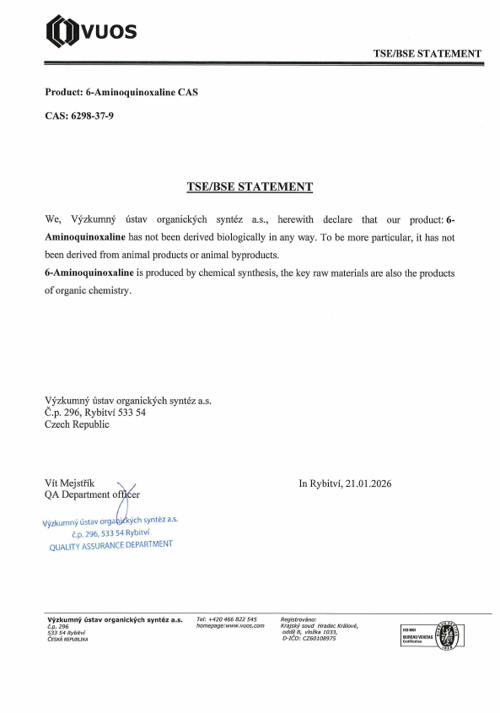
Quality System in raw material sourcing
Supplier qualification
Supplier annual evaluation and rating
Supplier audits on-site or on-line
Multi sourcing
TSE/BSE statement
GMO statement
Periodic internal process audits and evaluation
Supplier evaluation
Audit report TSE/BSE Statement

Slide 4
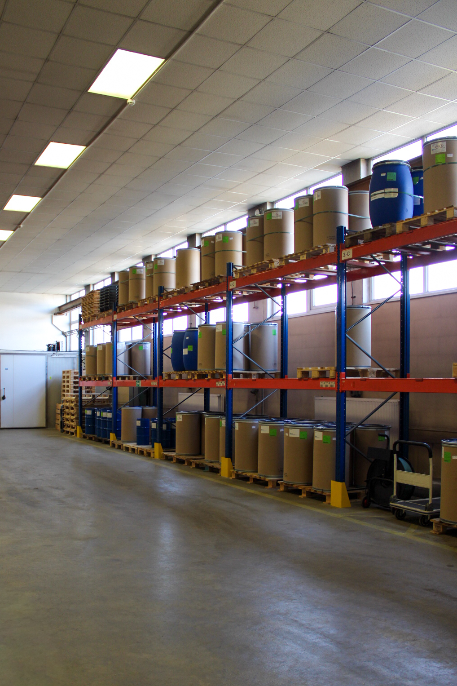
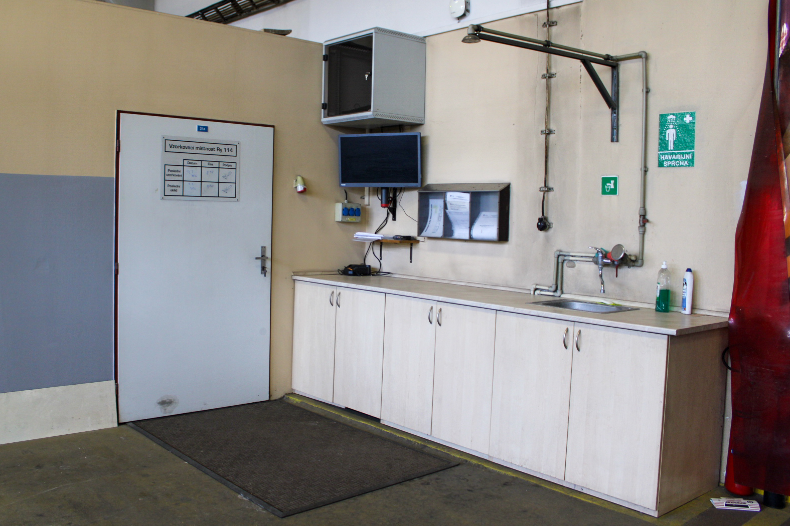
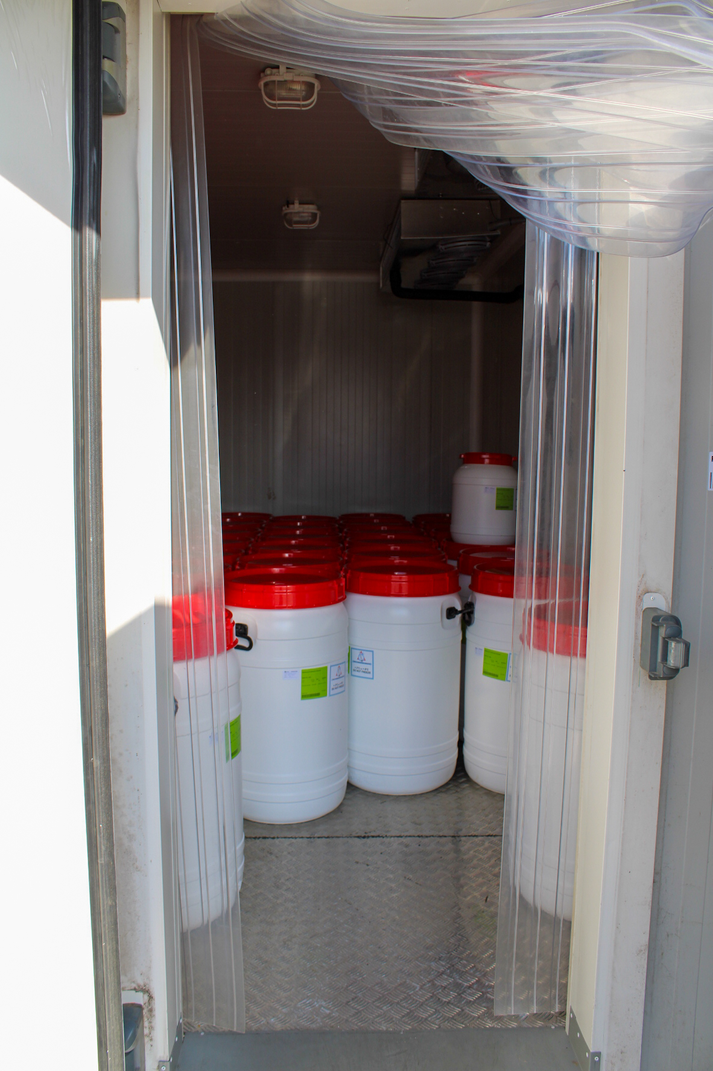
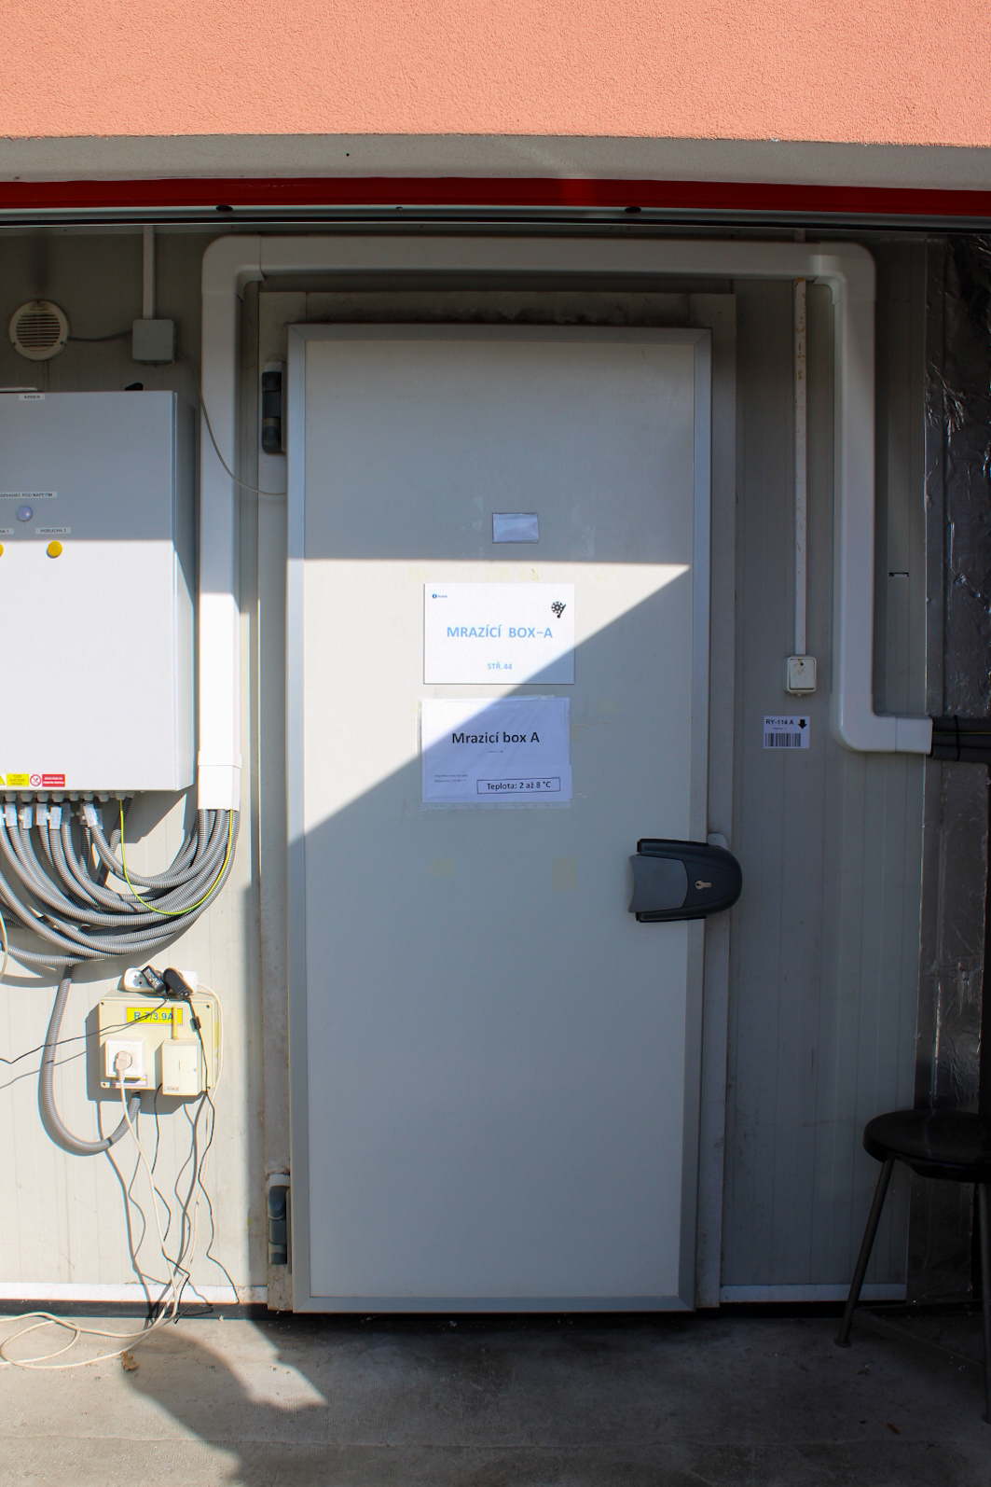
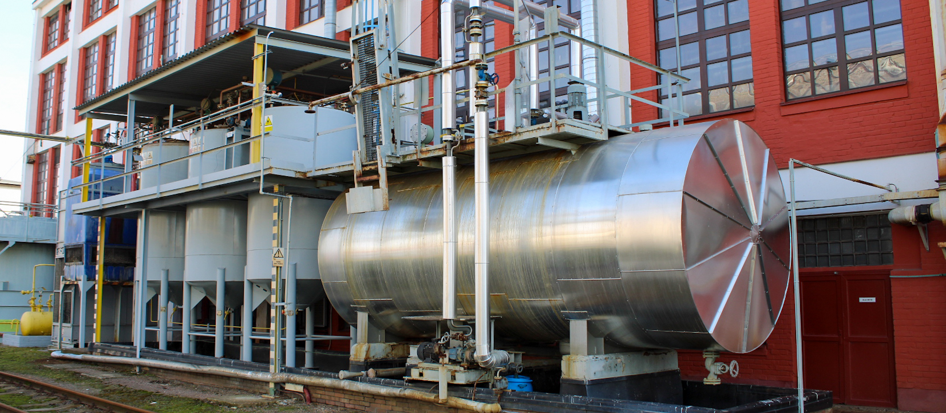
Material storage - warehouses
Raw material warehouse
Finish Product warehouse
Flammable liquid warehouse
Cold warehouse 5ºC
Low temperature warehouse -18ºC
Technical gas warehouse
Storage tank warehouse
4

Slide 5
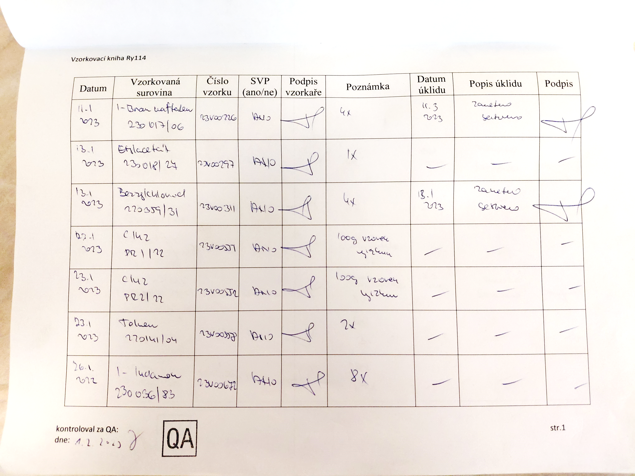
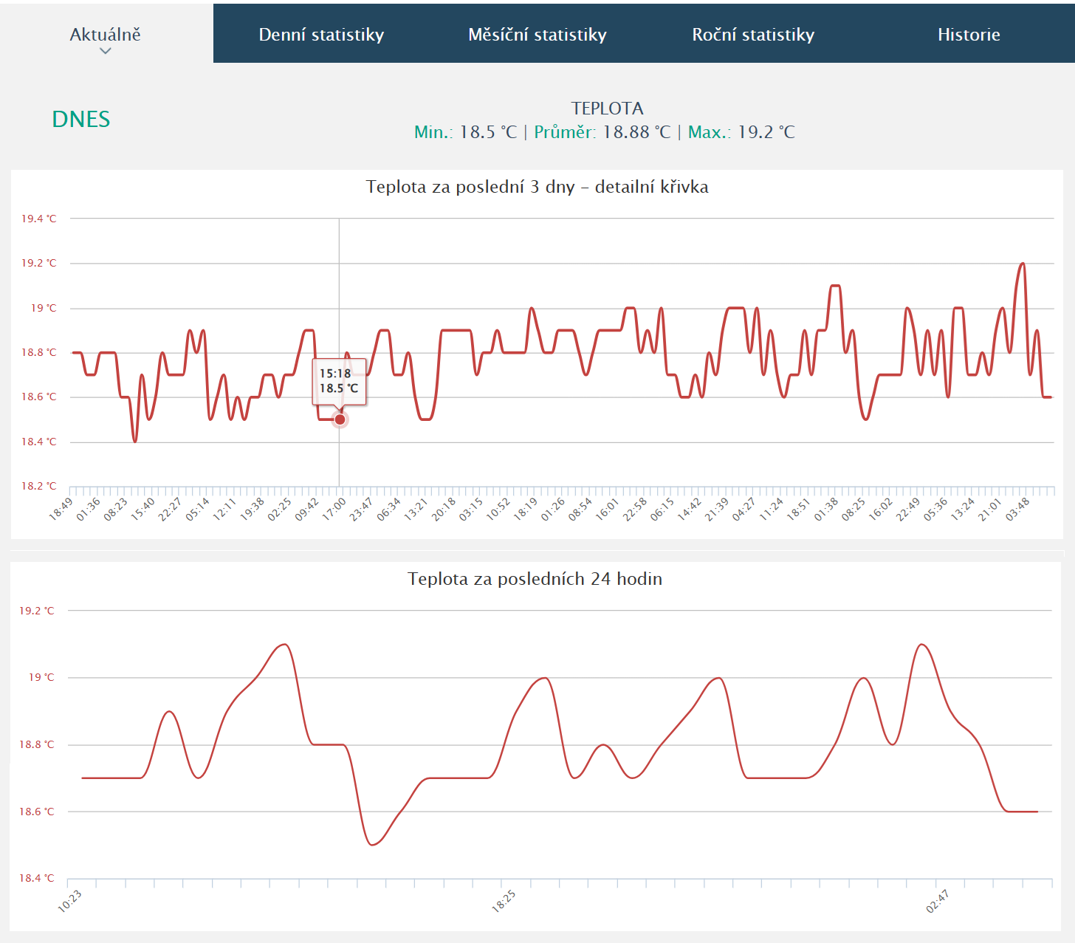
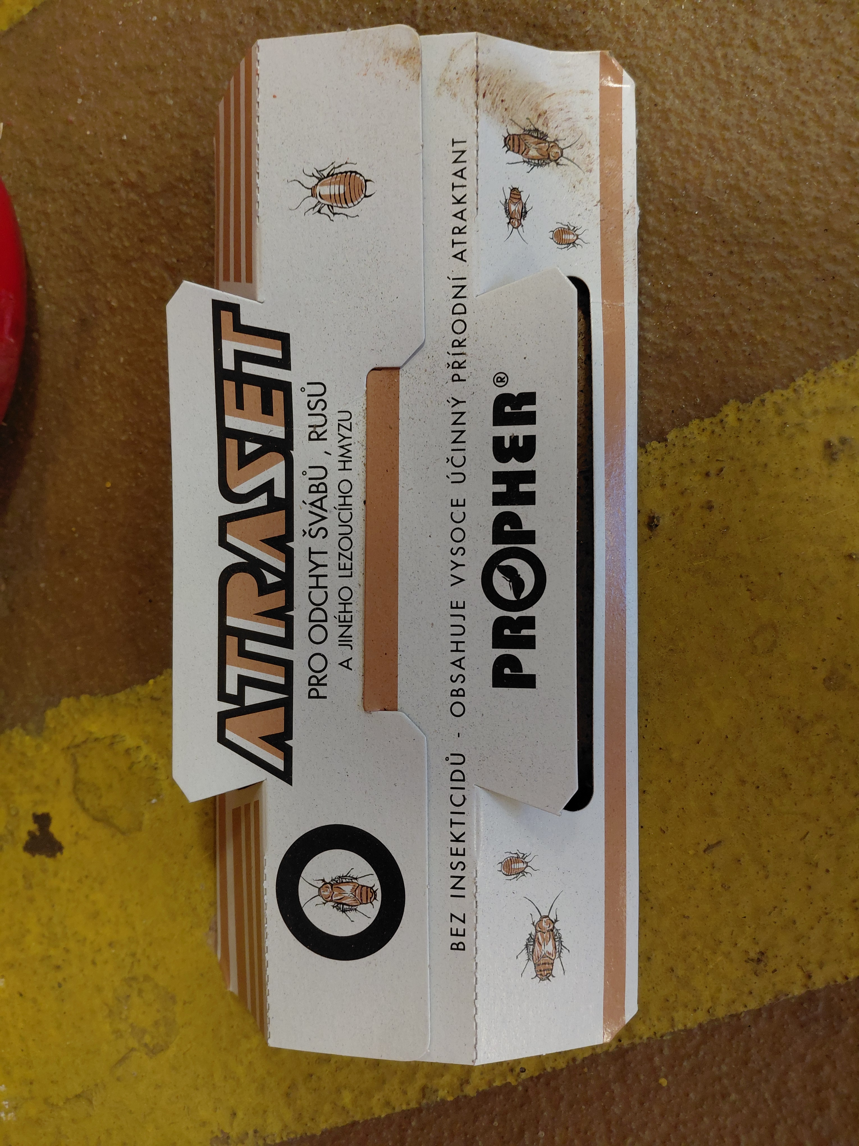
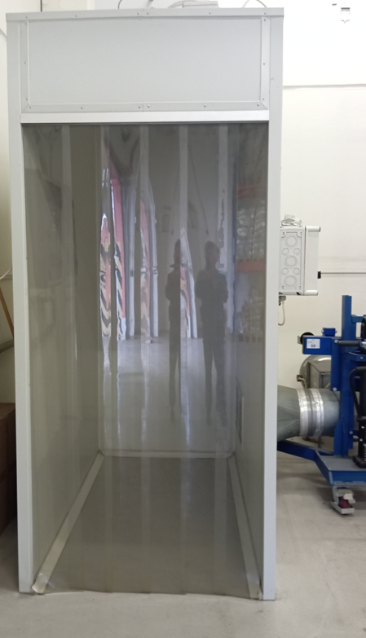
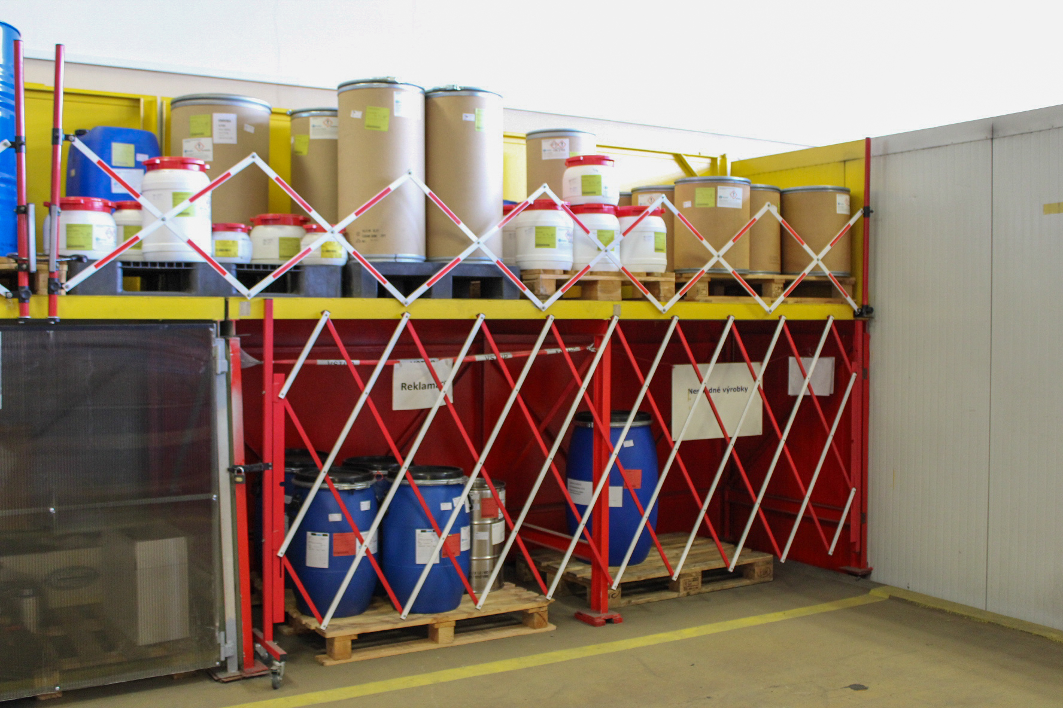
Quality System in Warehouse
Temperature Control– online, on the intranet, temperature maps after 4 years
PET control – traps for rodents, crawling insects and flying insects (UV lamps), trap maps and regular inspection
Warehouse cleaning – cleaning sheets
Sampling room – there is ventilation, cleaning, a logbook of what was sampled and when
Material storage labelling and storage system
Quarantine – white labels
Raw materials zone –approved by QA with green label
Final products zone –approved by QA with green label
Expired substance zone – yellow shelves, yellow
Non-conforming substance zone – red shelves, red labels
temperature monitoring cleaning sheets
pest control sampling box

Slide 6
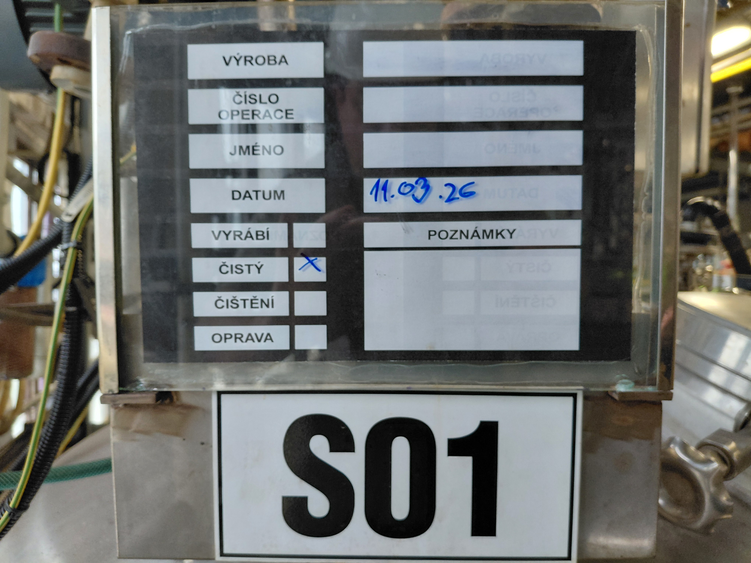
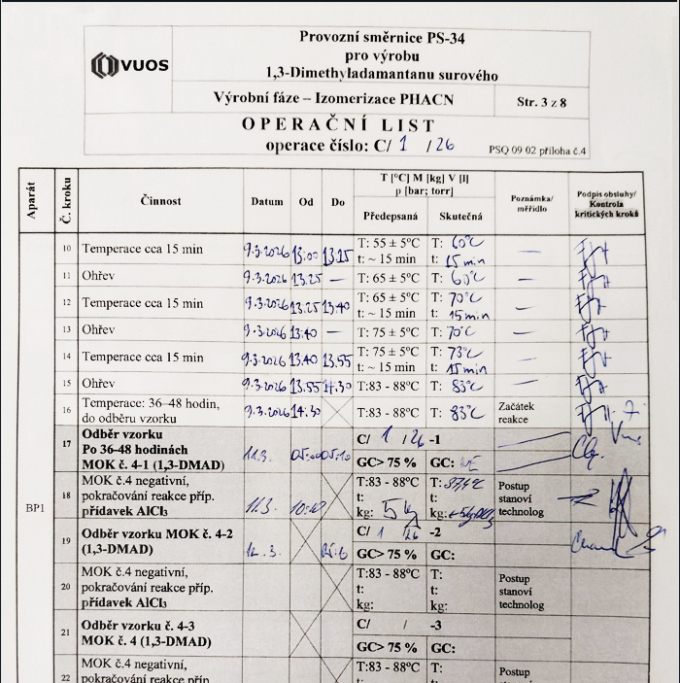
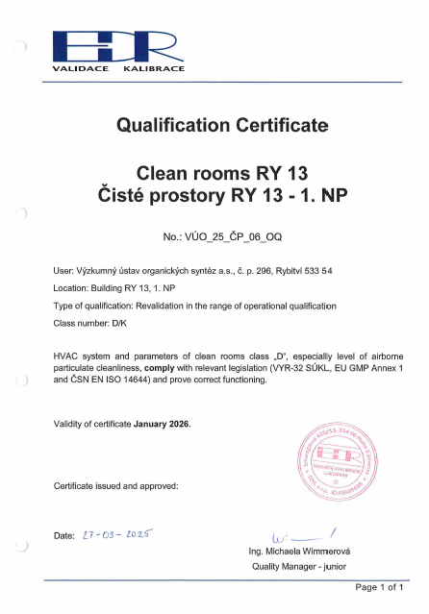
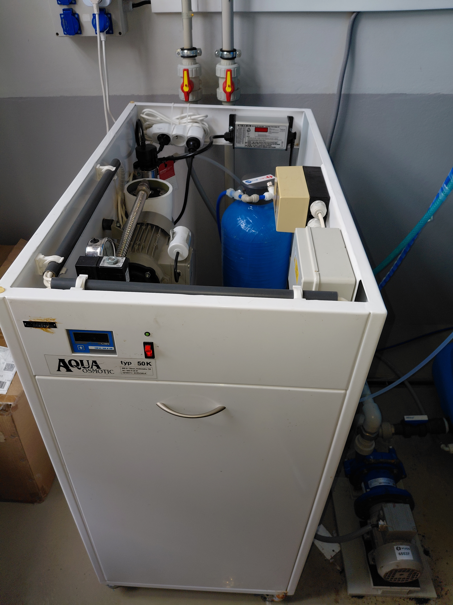
Quality System in Production
Preventive maintenance management
Equipment labeling system
Production equipment qualification
Production room qualification
Process validation
Cleaning procedure validation
Status Label
Computer system validation
equipment status label
batch record
clean room qualification
water sterilization

Slide 7
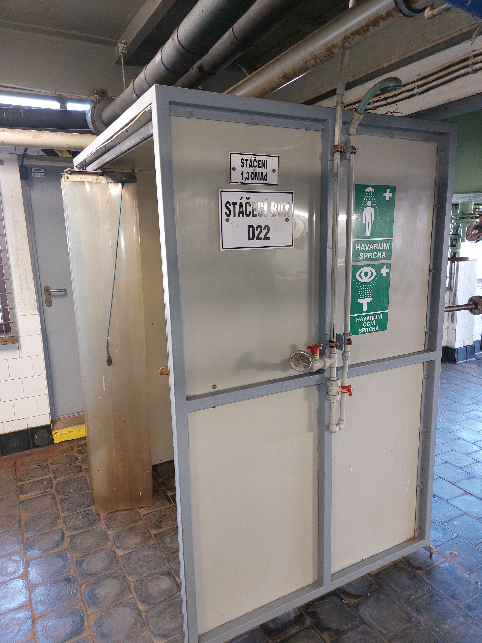
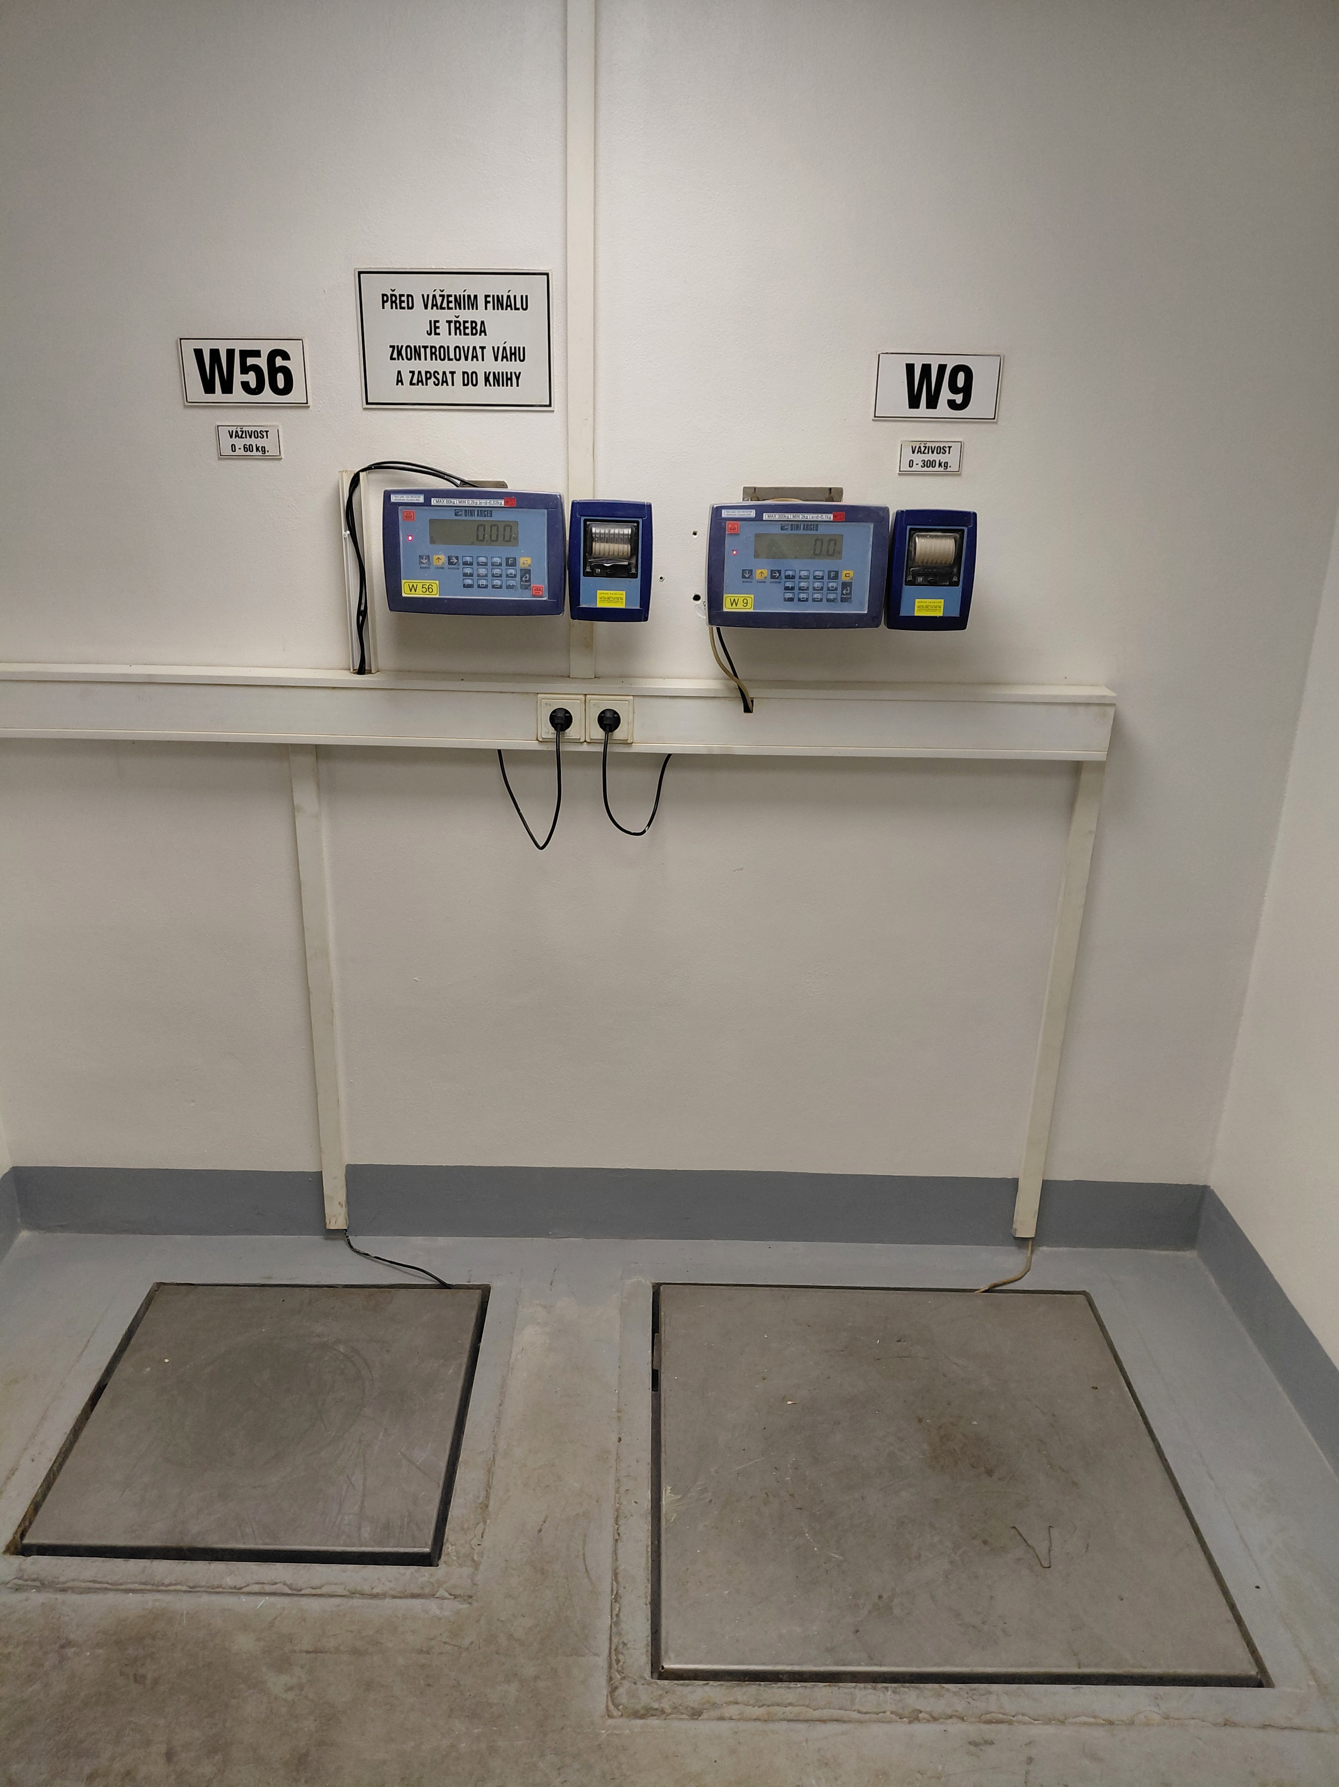
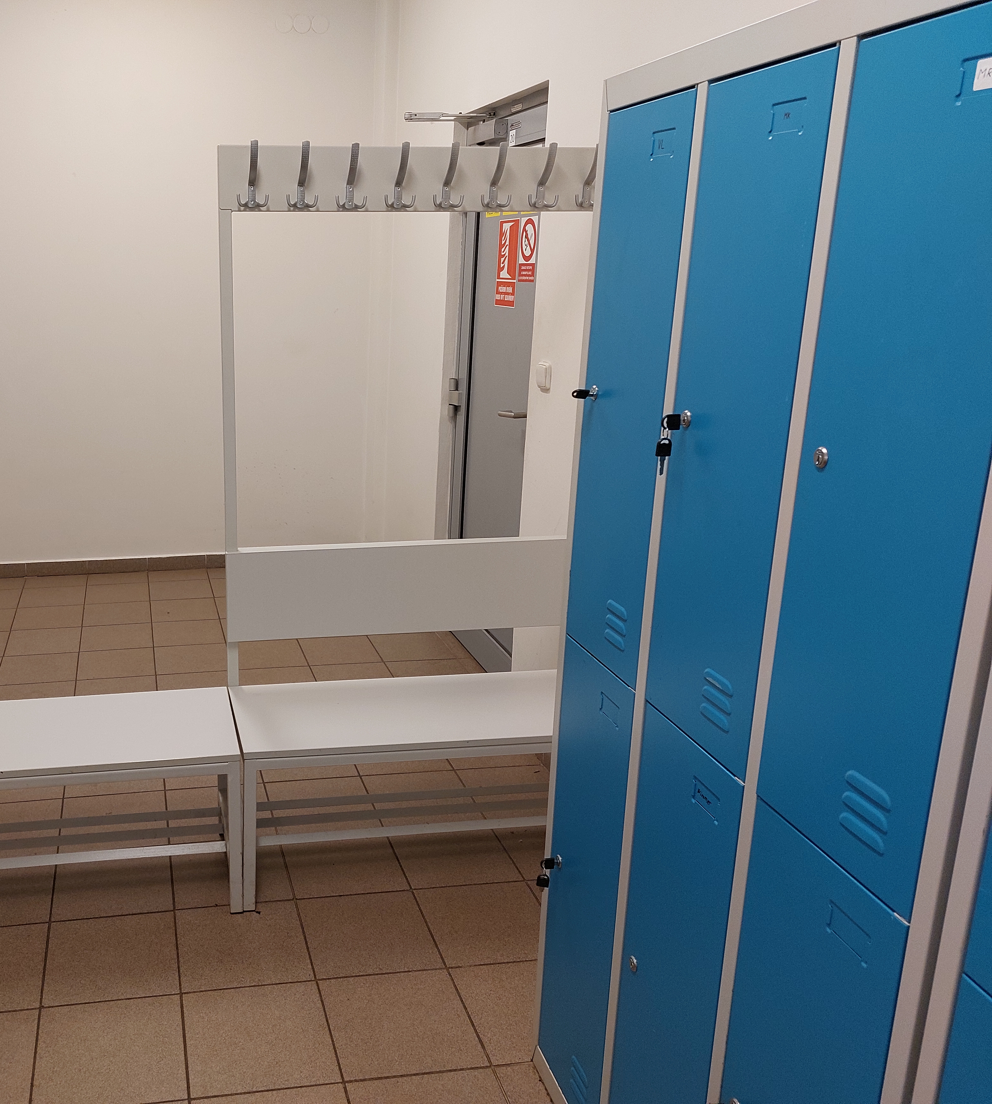
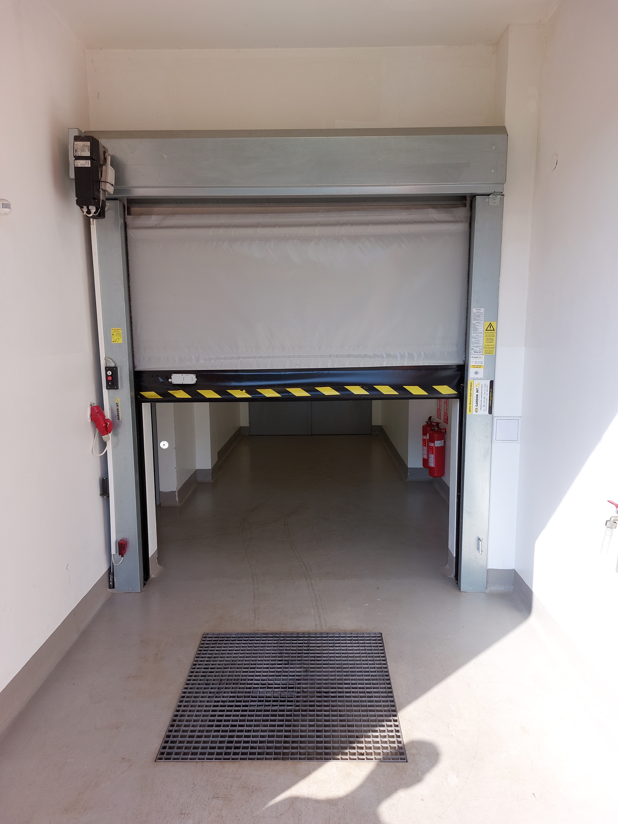
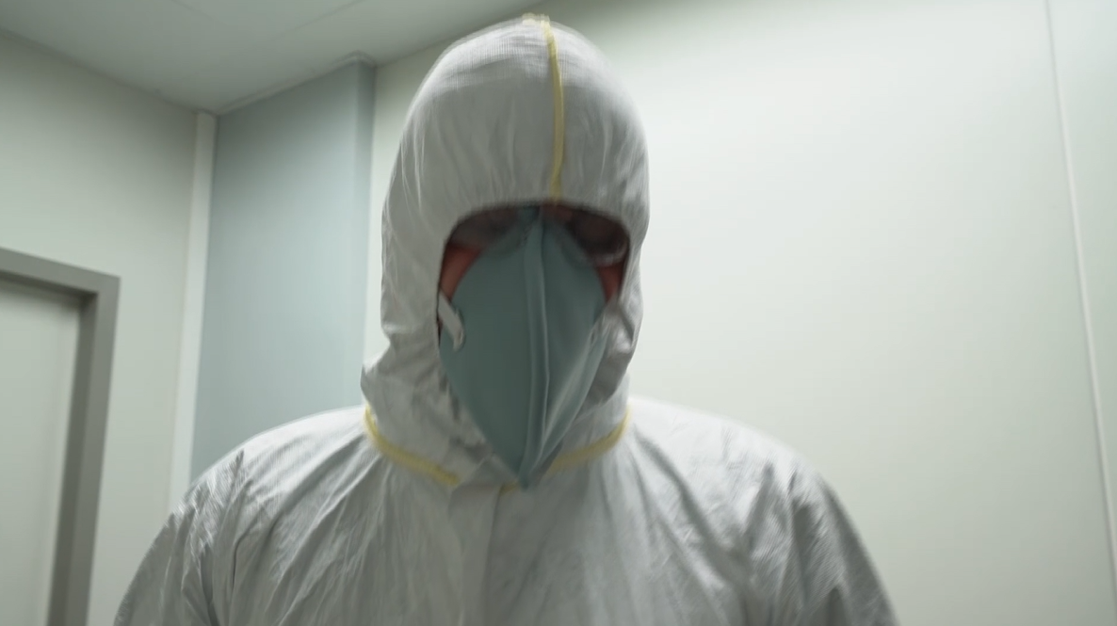
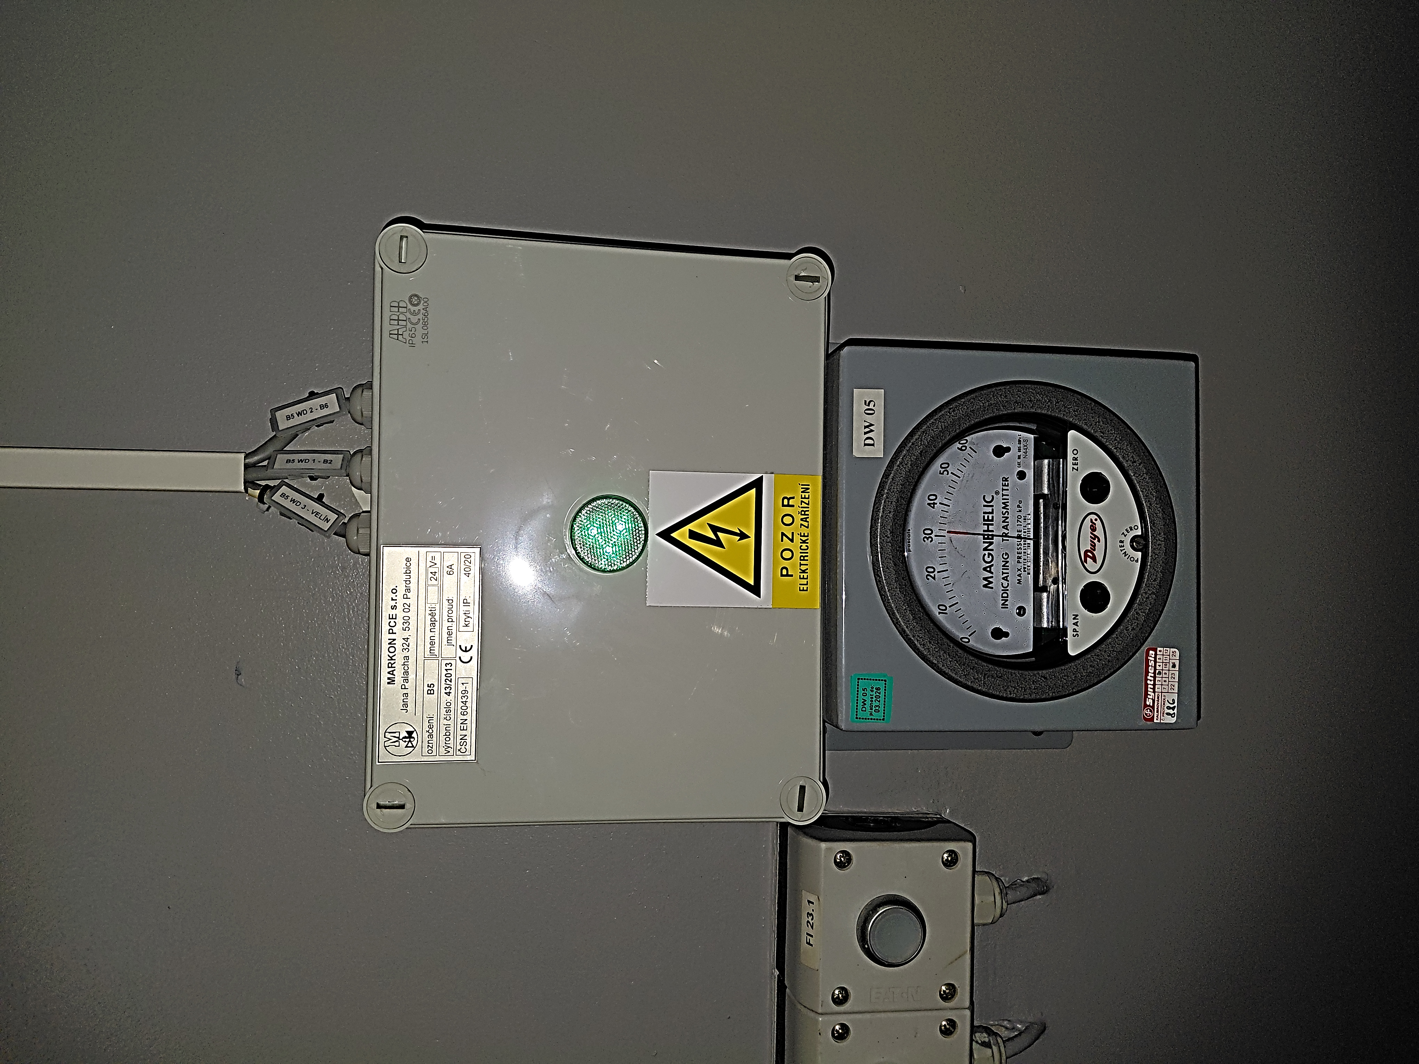
Crosscontamination control in production
Starting material
  Weighing and sampling room
  Protected areas for material handling and filling drums
Pharma Intermediates +
  Material airlock
  Personnel airlock
  Air filtration (HEPA Filters)
API production class D clean room +
  Air partical control
  Water UV desinfection
  Microbiological contamination control
Filling boot
Weighing area
Personal airlock Material airlock
7

Slide 8

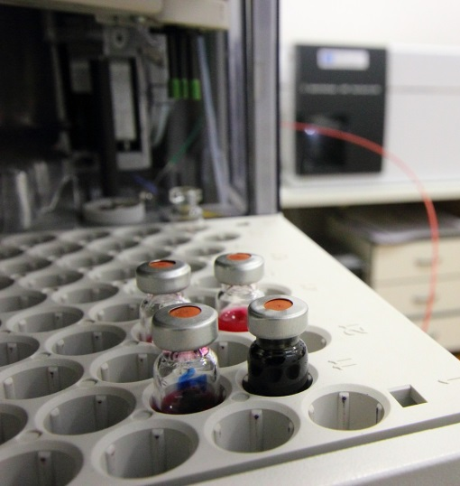
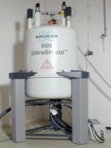
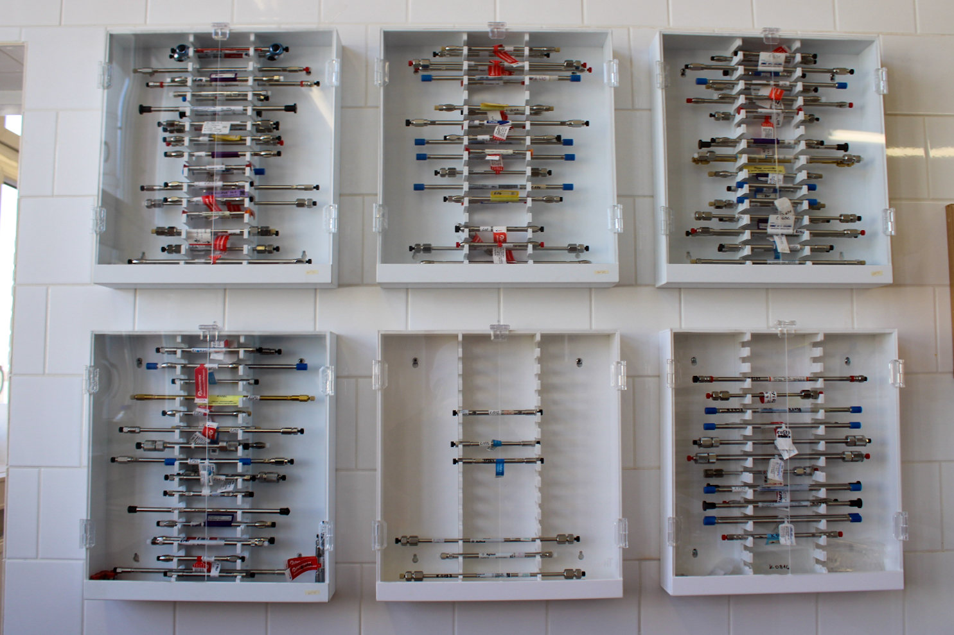
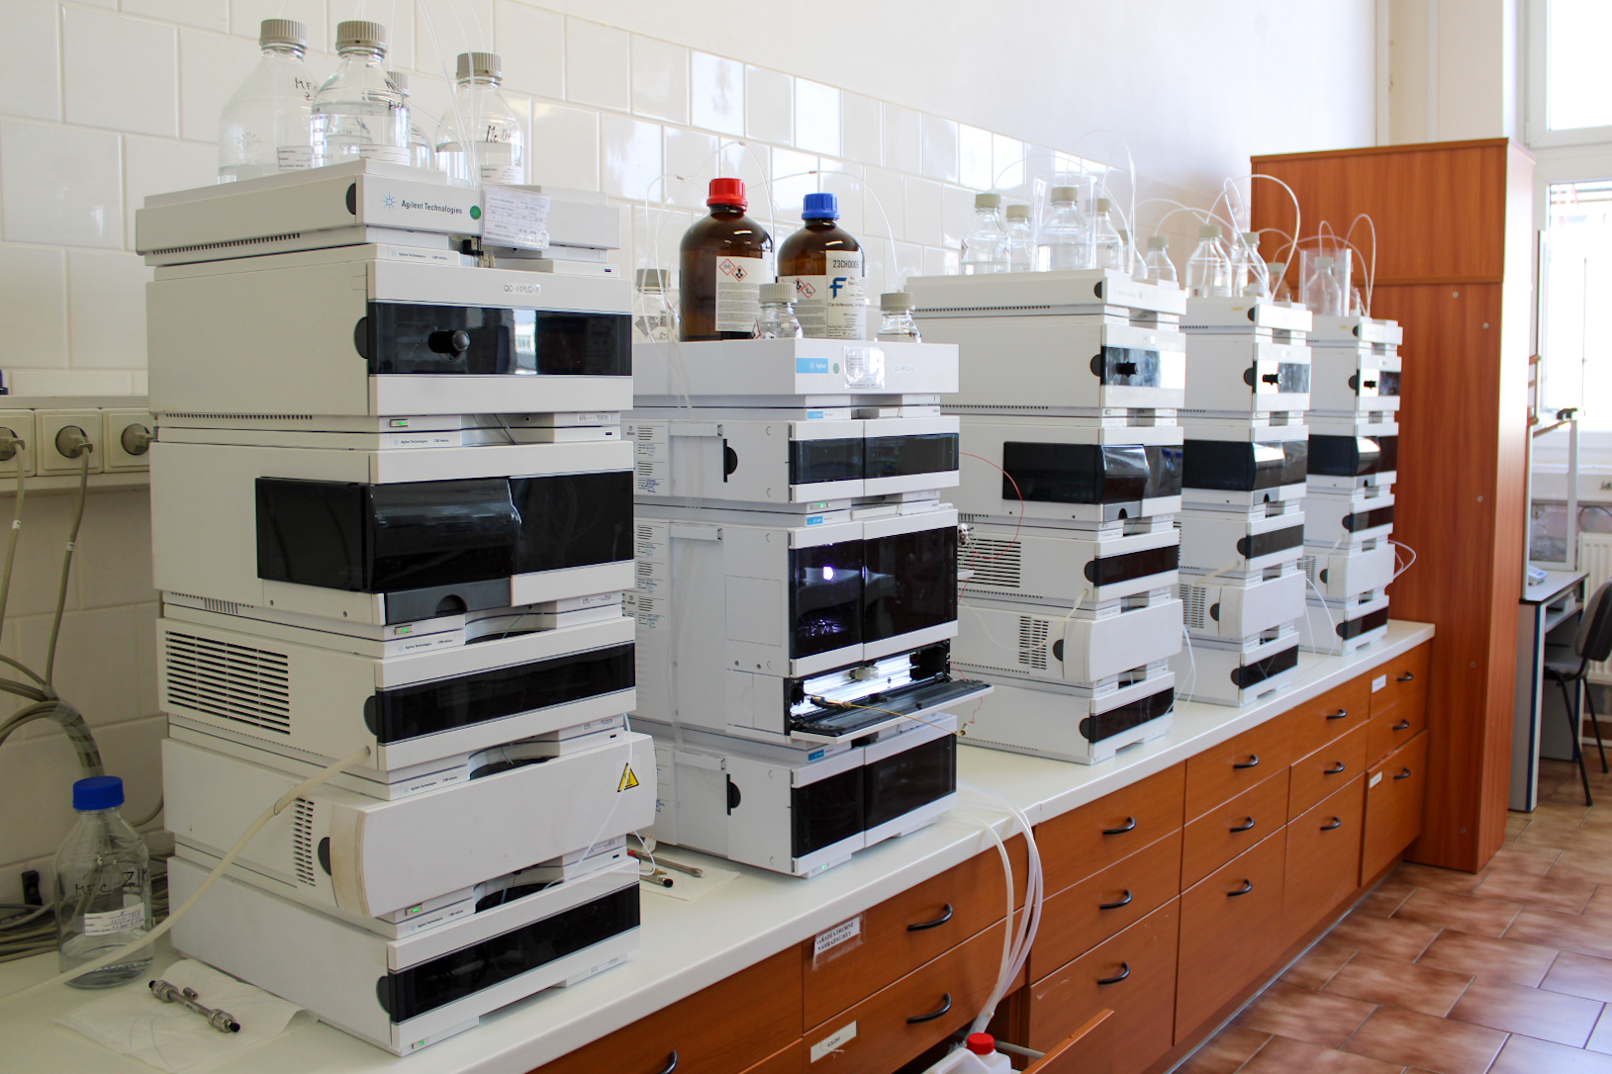
Quality control equipment
NMR Spectrometry (500 Hz, 400 Hz)
Mass Spectrometry (LC/GC-MS)
ICP-AES
IR Spectrometry
Chromatography (HPLC, GC)
UV-VIS
DSC
Particle size analyzer
And other technics
8

Slide 9
Qaulity Control System
IT Laboratory Management System (LIMs)
Qualification of laboratory instruments
Maintenance laboratory systems
Audit trail
Measurement of inputs, IPC, outputs
OOS and OOT solutions
Stability studies
Validation of analytical methods
Residual solvents
Packaging material analysis Stability studies
Complaints
Validation of analytical methods
Residual solvents
Packaging material analysis
Complaints

Slide 10
Quality Assurance System
Controlled documentation (revisions, new editions, employee familiarization/training)
Change management system
Deviation and CAPA system
Site Master File
QMS management Validation
Validation Master Plan includes:
  Qualification of equipment, production rooms, media
  Validation: process, cleaning, PC systems
  temperature maps
  analytical methods PQR,
  Risk analysis for critical steps and production processes

Slide 11
Quality Assurance System
Input raw materials area
OOS, OOT
Approval and generation of certificates for input raw materials, IPC and final products
Approval of suppliers for APISM (API Starting Material)
TSE/BSE, GMO requirement
Annual review of PC systems
Data Governance - ALCOA++
Data integrity and audit trail
Training in ISO 9001 and GMP systems
GDP compliance,
Personal hygiene
Self-Inspection

Slide 12




Sustainability and ESG is Essential
Environment: Decreasing of CO₂ emissions, water savings, solar energy production, heat recovery
Social: Respect to gender neutrality and equal pay for equivalent work, training in ESG and Human rights, Continual improvement of HSE management
Governance: Two-tier system of governance, Compliance management system, Cyber security, Whistleblowing hotline
12

Slide 13
CDMO partner for your projects
VUOS, a.s.
c.p. 296, Rybitví 533 54, Czech Republic
www.vuos.com | info@vuos.com

