Slide 1




Company Profile
VIDEO PRESENTATION
11/11/2025

Slide 2
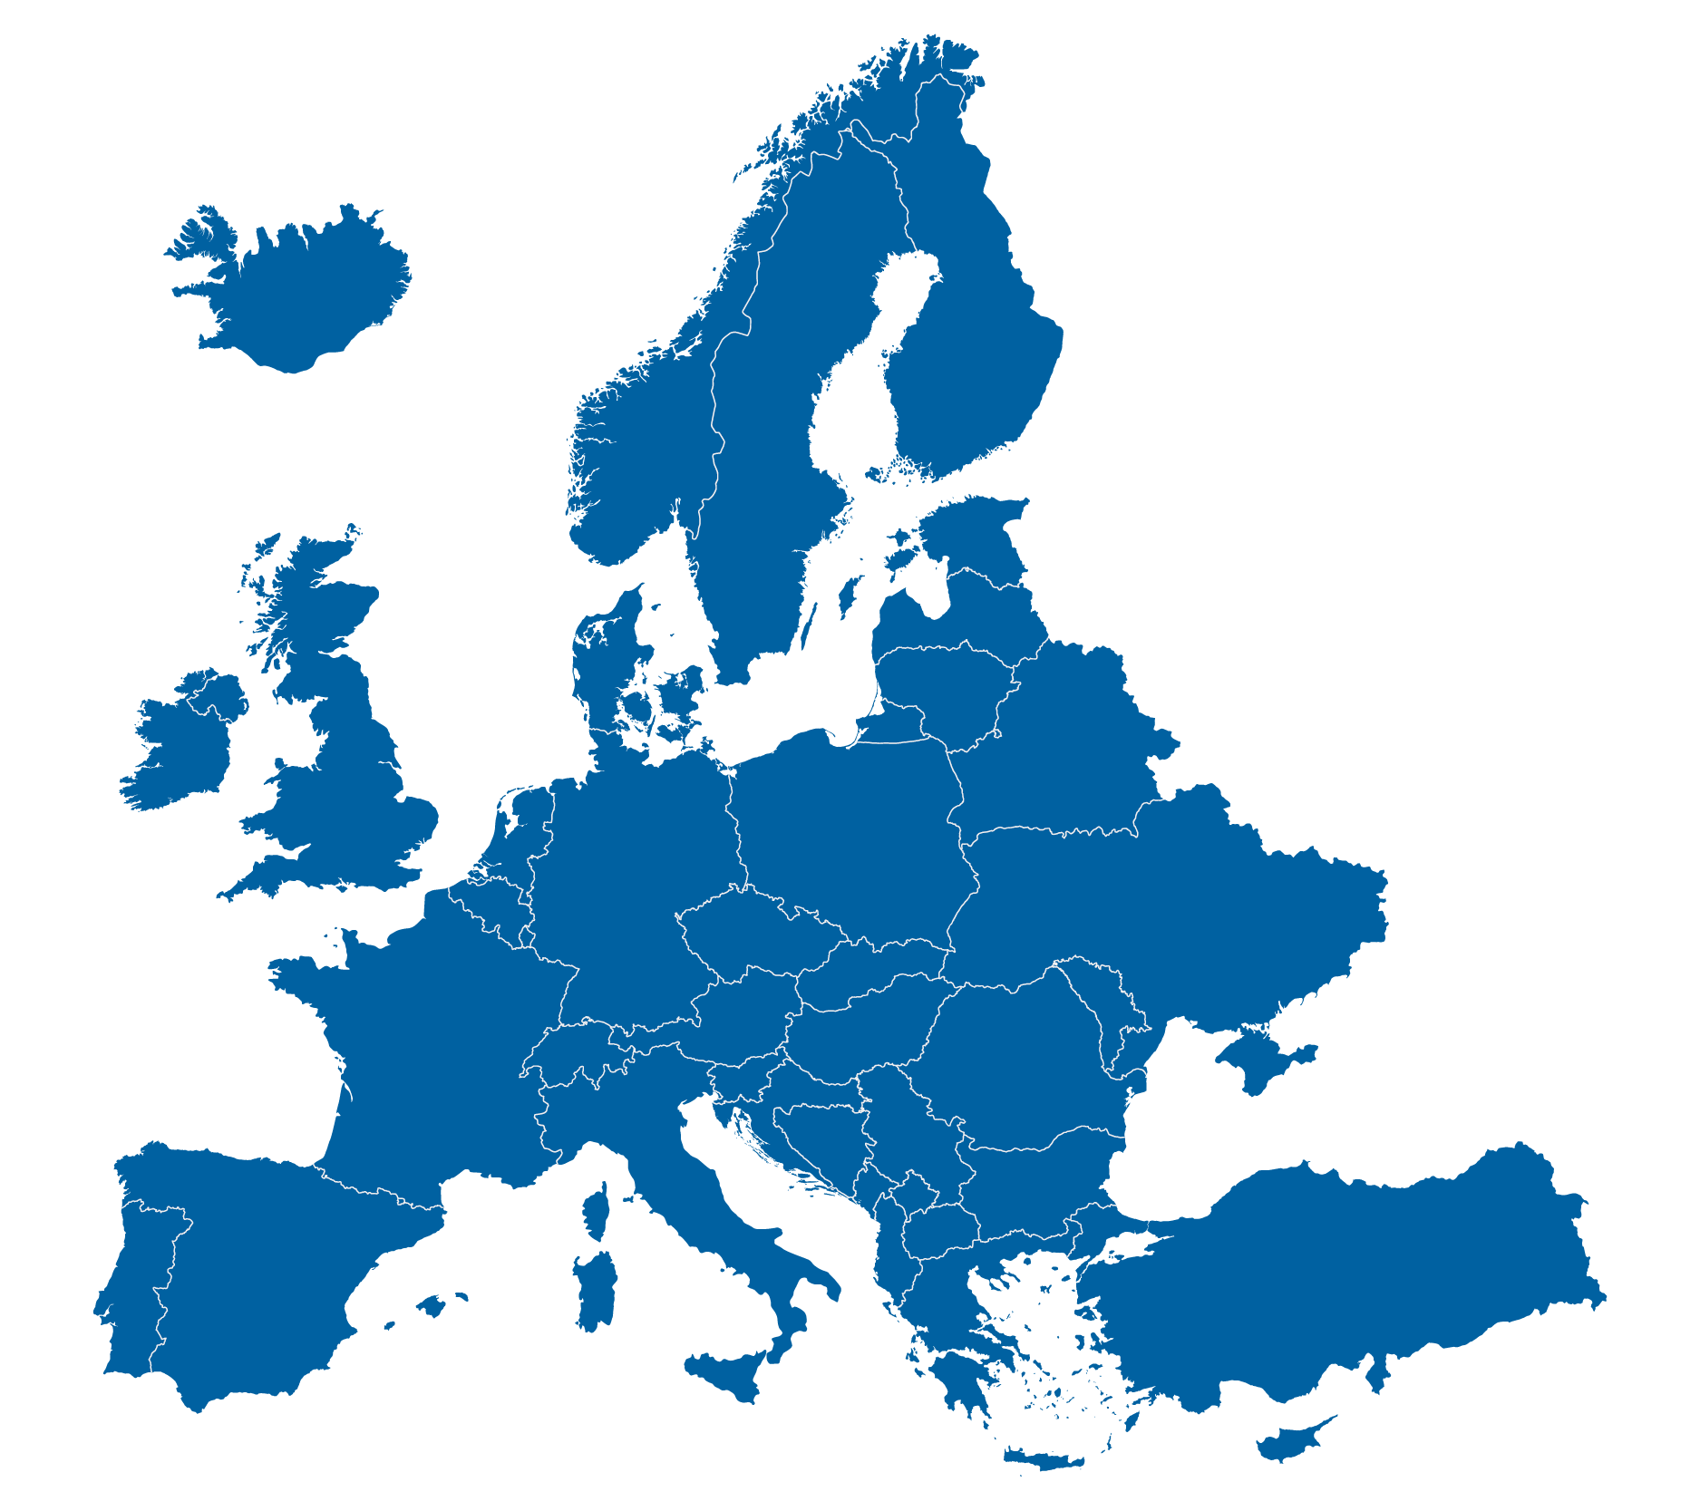

Reliability, Stability, Sustainability from Heart of Europe
More than 95% inputs we buy in Europe
More than 72% products we sell in Europe
No Duty within Europe
Stable and predictable situation
High environmental protection standards
2

Slide 3
Know-how - Based on History – Future-oriented
1997
119 mil. CZK
2004
191 mil. CZK
2014
254 mil. CZK
2025
360 mil. CZK
Founded in 1941 in Rybitví
More than 80 years of experience in the field of R&D, scale-up and production of specialty chemicals
Advanced equipment
Fellow new trends
1941 Foundation of Laboratories
2002
Change into production Company
2014
GMP certification
2023
new cGMP line
3

Slide 4

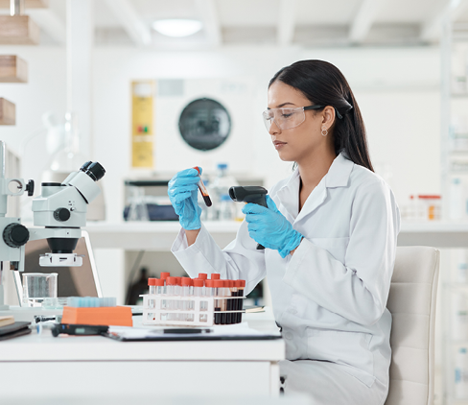
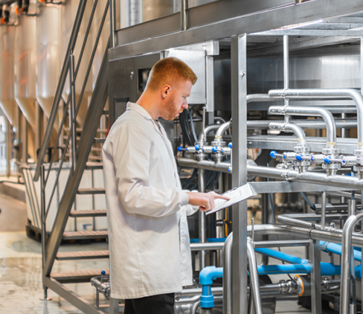
R&D, Technology Development, Innovation
160 Experts team of researchers, analysts, process engineers and toxicologists
50% of employees with University degree (M. Sc., 10% Ph.D.)
Co-operation with University of Pardubice
Wide knowledge of chemical syntheses, process and analytical techniques
4

Slide 5
Comprehensive Services - from R&D to Market
Services from research to industrial practice R&D → Production → Customer
Synthesis and process optimization
Scale-up from lab up to production
Flexibility for needs of all customers
Strong R&D
Kilolab 500 m²
Starting material production 120 m³
Advance material production 40 m³
GMP unit class D
Analytics
and toxicology
5

Slide 6
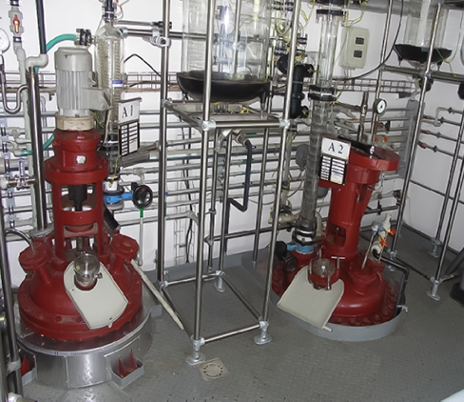
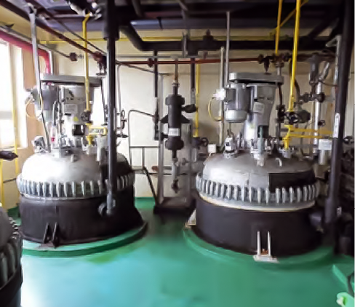
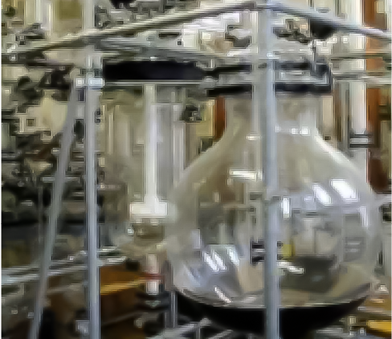
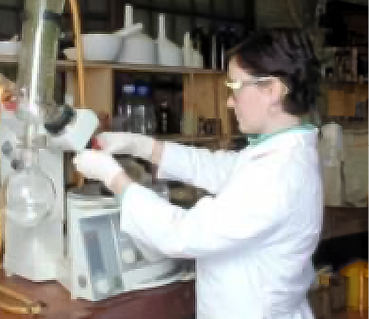
Scale from Small to Big, from Starting Material to API
Vessels from 1 to 6 000 l
Production Standard from Starting Material to API Clean Rooms Class D
Scale-up
Laboratory
Kilolab (500 m²)
Pilot (25 m³)
Production (120 m³)
6

Slide 7
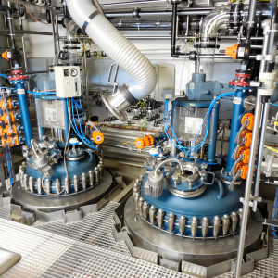
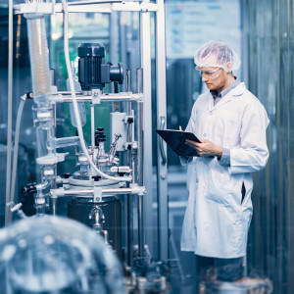
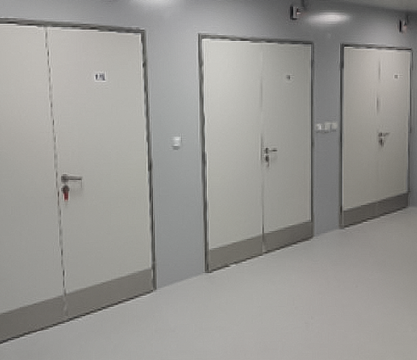
Wide Range of Technology in Pharma Standard
Key chemistry
Adamantane derivatives
Nitrogen-containing heterocycles
API building blocks
Technology
Reduction a high pressure Hydrogenation
Cryogenic reaction (RLi, RMgX, RR‘Zn)
Coupling reactions (Suzuki, Kumada, Heck, etc..)
Phosgenation, Halogenation, Nitration, Sulfonation
Vessels: autoclaves up to 1000 l, reactors 1–6000 l, distillation and rectification
7

Slide 8


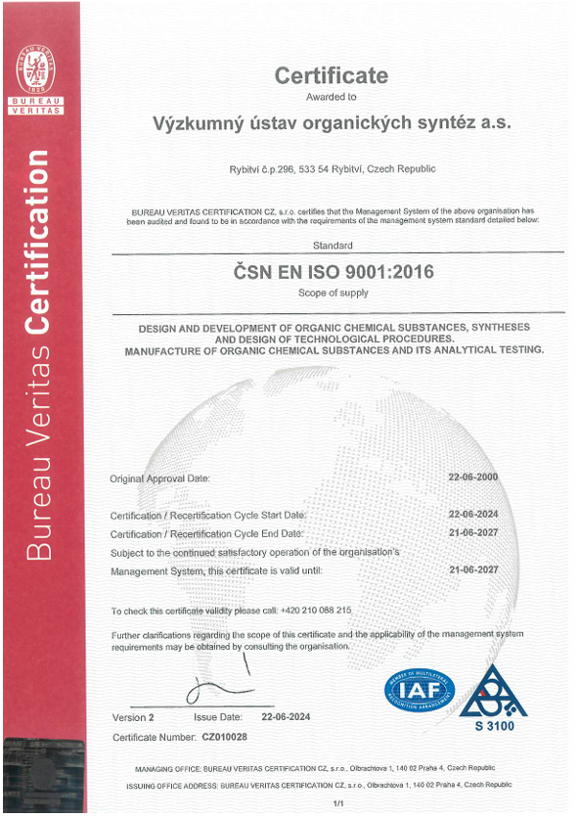
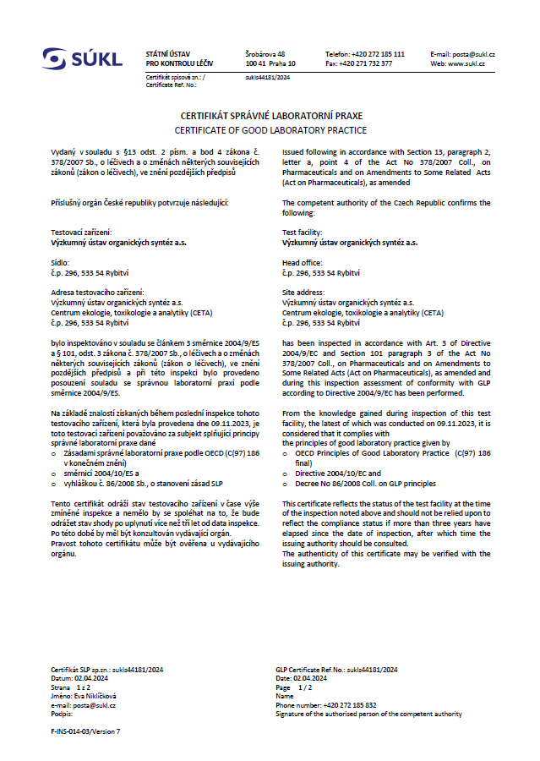
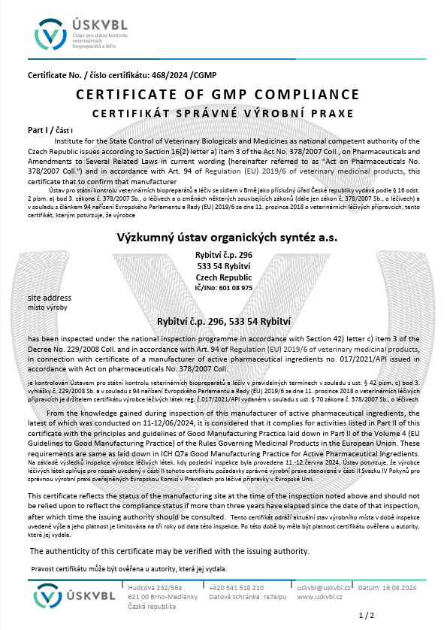

Robust Quality Systems
Certification: ISO 9001:2016, GMP, GLP
Audited by Czech and EU Authorities
Audited by many customers
8

Slide 9
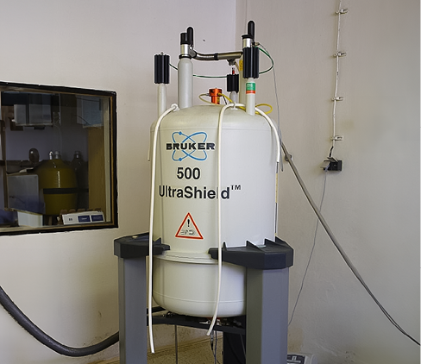
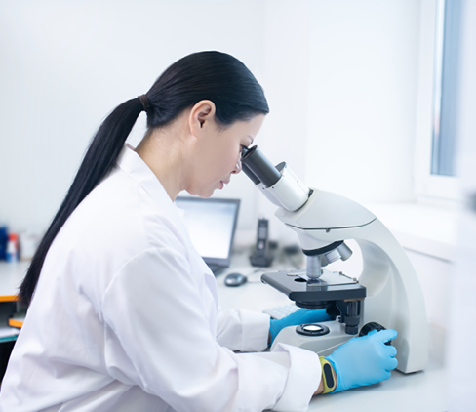
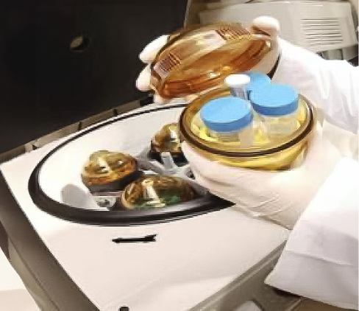
More than CDMO - Analytics and Toxicology
Analytical method development and validation
Stability Studies
Impurities identification
Wide portfolio of techniques
Toxicology testing
Ecotoxicology for API
REACH & CLP services
9

Slide 10




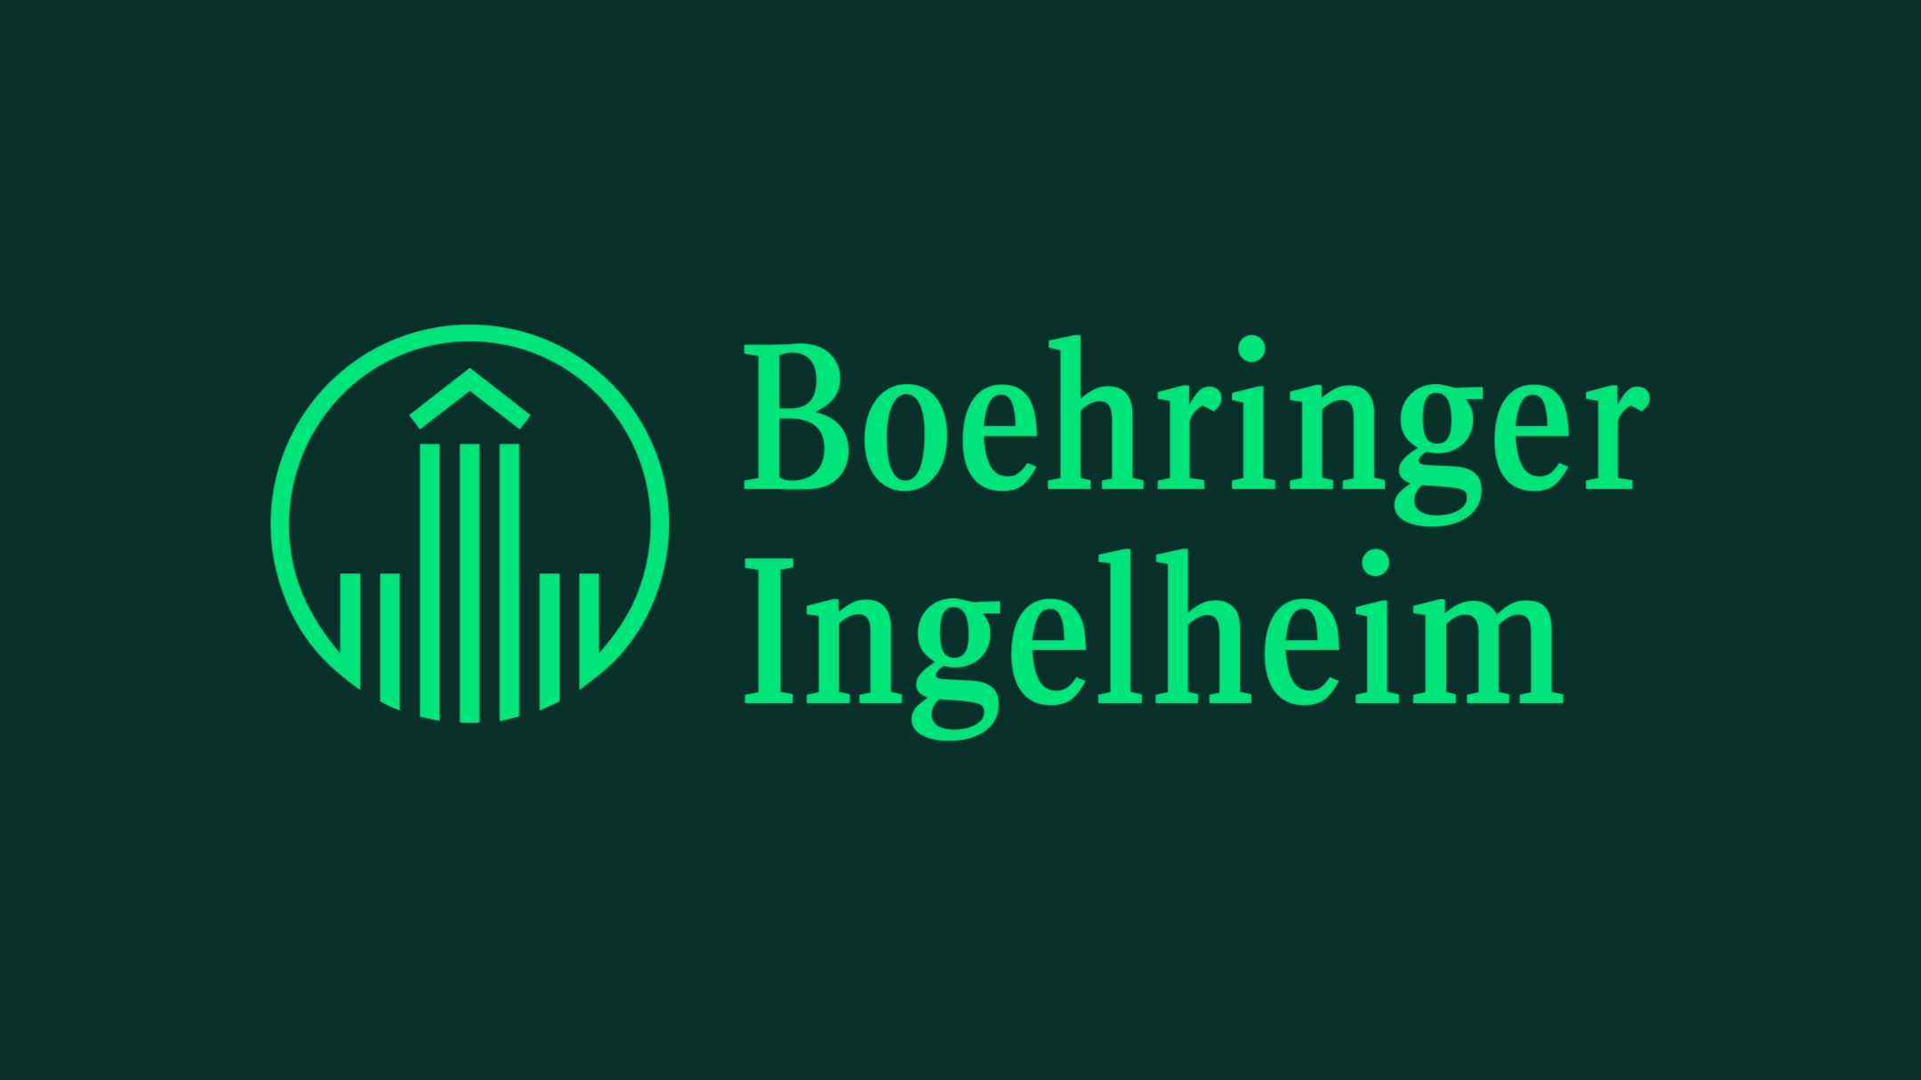
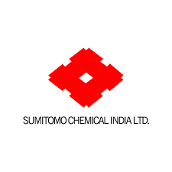




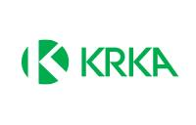
Partner for Big Pharma and SMEs
Partners in Pharma:
5 Big Pharma
More than 50 Small and Medium-Sized
Enterprises
Focus on Original and Generics API
Others:
▫ Microelectronic
▫ Security printing pigments
▫ Custom syntheses
10

Slide 11



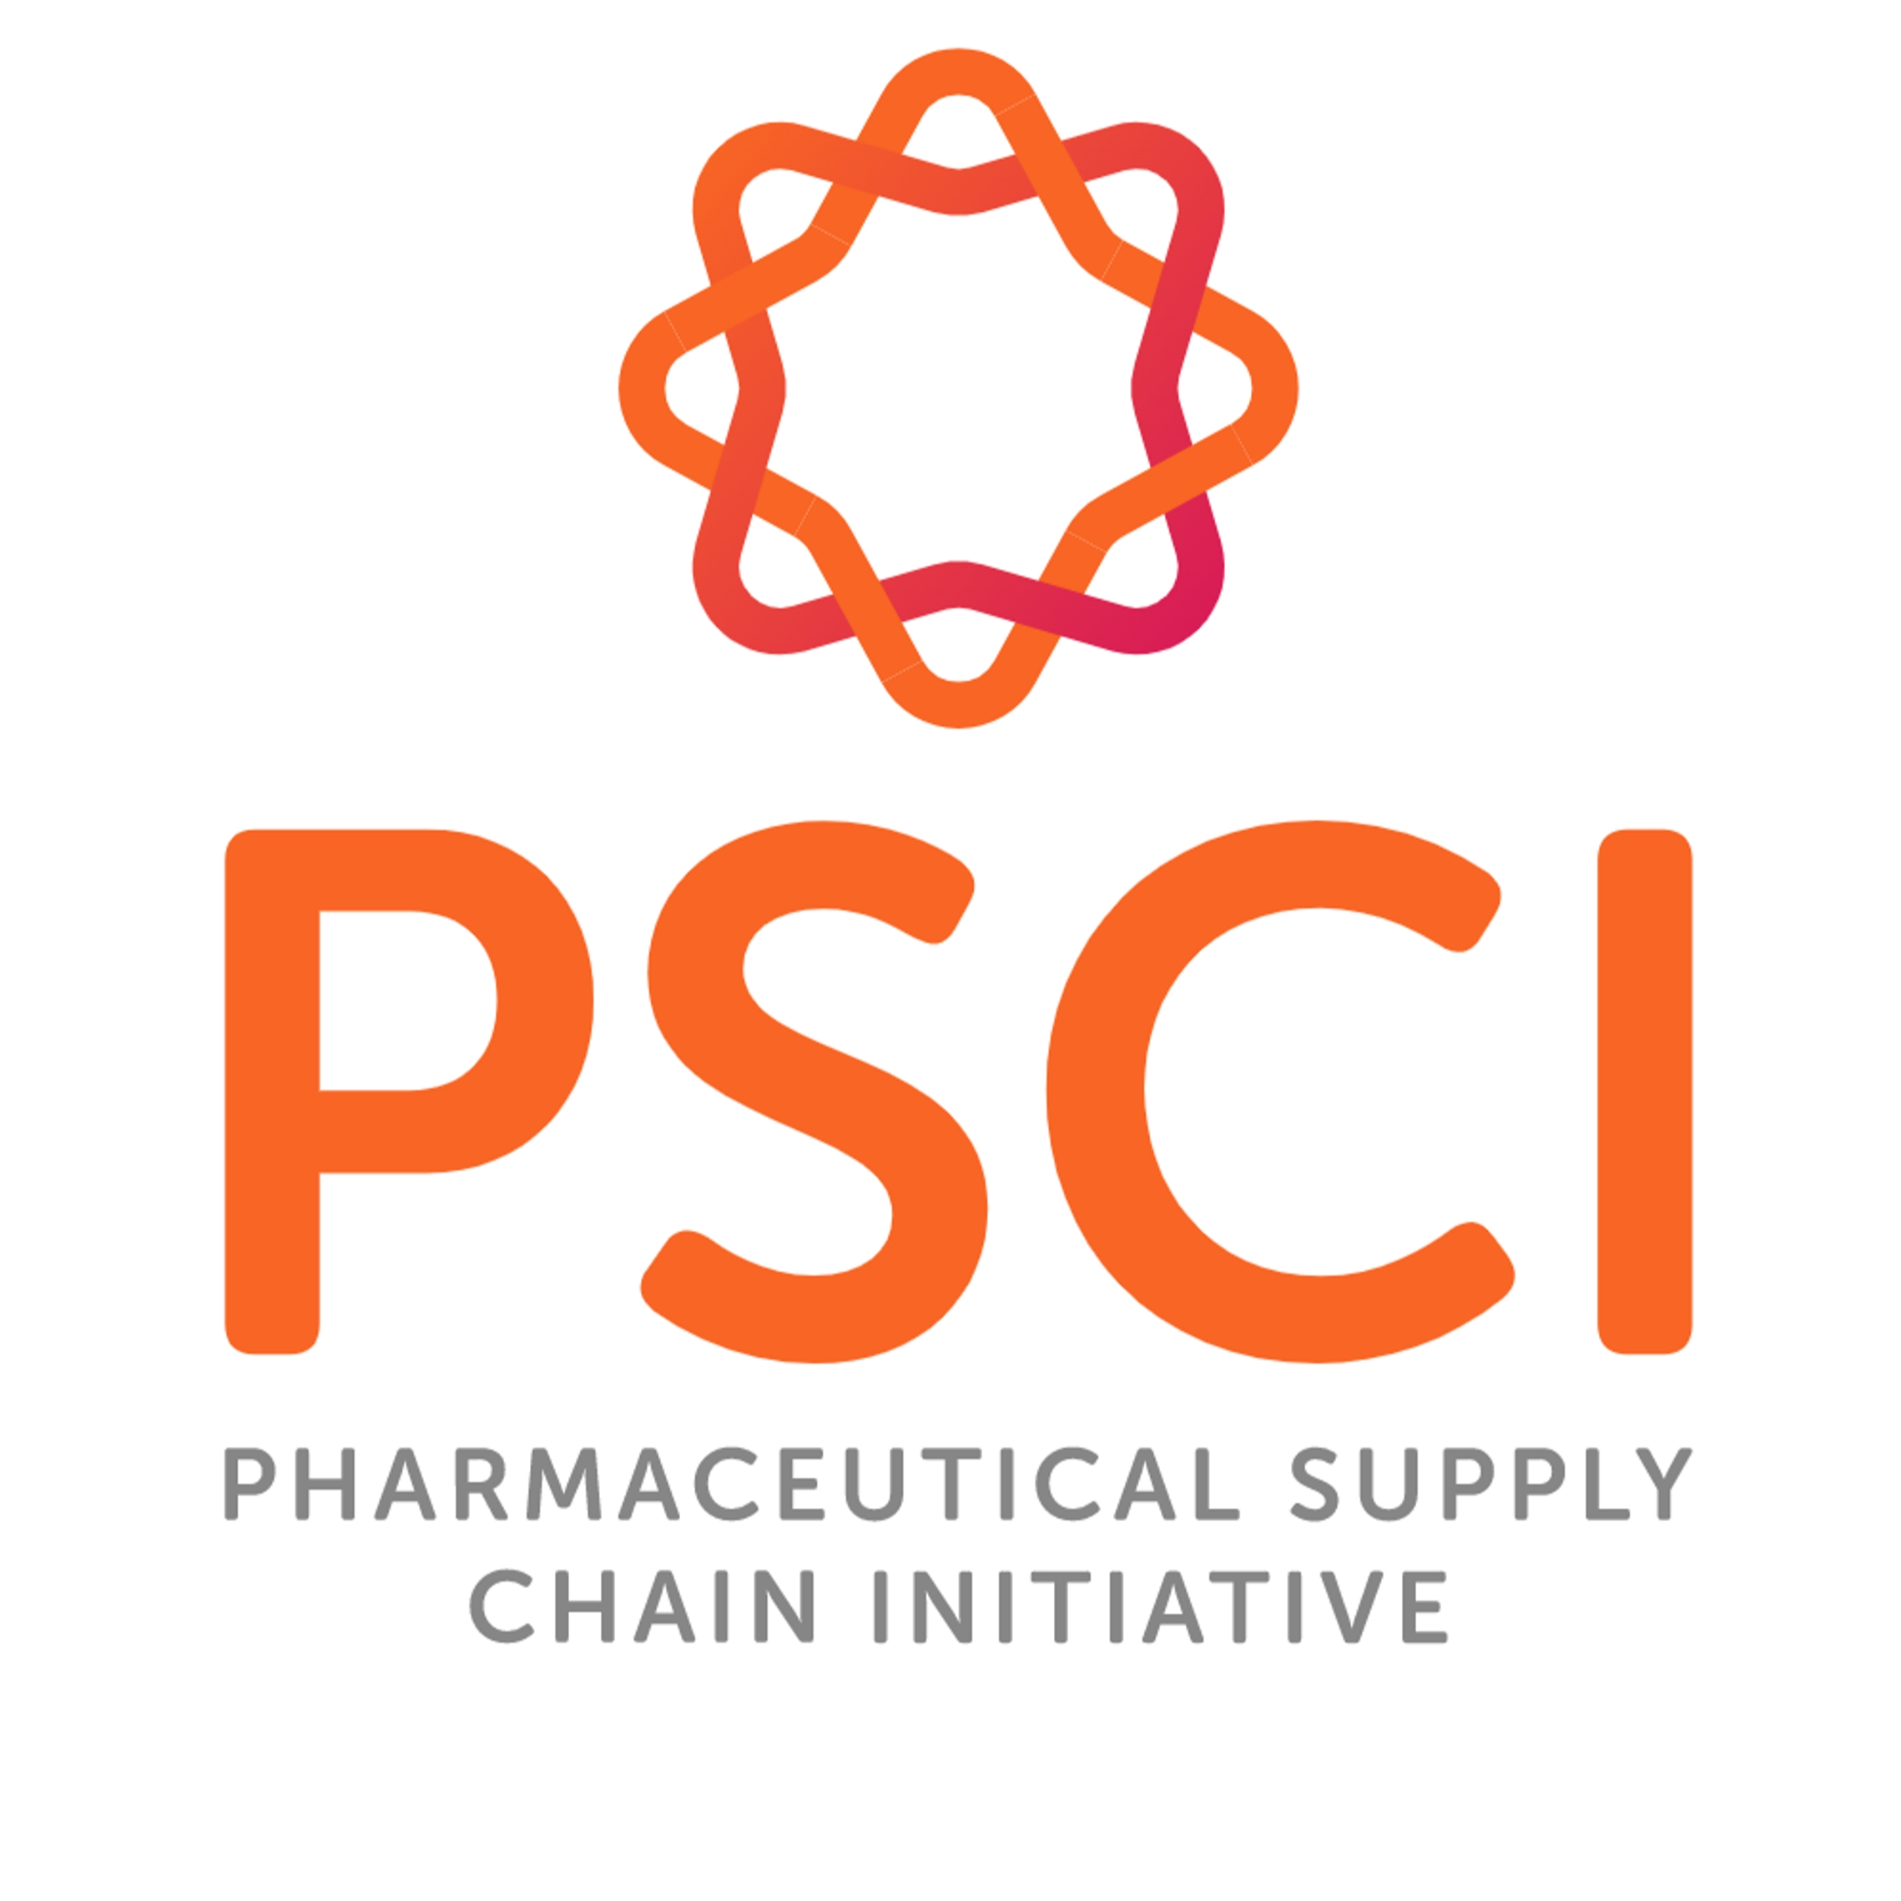
Sustainability and ESG is Essential
Environment: Decreasing of CO₂ emissions, water savings, solar energy production, heat recovery
Social: Respect to gender neutrality and equal pay for equivalent work, training in ESG and Human rights, Continual improvement of HSE management
Governance: Two-tier system of governance, Compliance management system, Cyber security, Whistleblowing hotline
11

Slide 12

Why work with Us
80 years of tradition
Experienced team
From grams to tons
GMP/GLP/ISO certification
More than CDMO - R&D + Scale up + Analytics + Toxicology + Production
Flexible and reliable European partner
12

Slide 13
CDMO partner for your projects
VUOS, a.s.
c.p. 296, Rybitví 533 54, Czech Republic
www.vuos.com | info@vuos.com

